Slide 1
FRAME - Food Recommendations for All Methodical Eaters
DATA 515 Technology Review - 21-Feb-2023
Zach Bowyer
Raman S V
Arjun Sharma
Adithyaa V

Slide 2
Background & Use Case
Background:
Food delivery apps offer a lot of choices, leading to analysis paralysis and wasted time.
Users often struggle to make confident decisions about what to order.
Use Case:
Introducing a tool that provides a holistic approach to food ordering.
Users can filter choices based on cuisine, dietary restrictions, price, allergens, and nutritional value.
A curated list of 5-10 dishes and the restaurant from where it can be ordered is provided.
Currently focusing on people living in the Seattle area who want to order food quickly and easily without being overwhelmed by options.
Why we do need libraries:
Limited development time, no need to reinvent the wheel for proven algorithms/technologies when it comes to maps, data processing, data organization, etc.

Slide 3
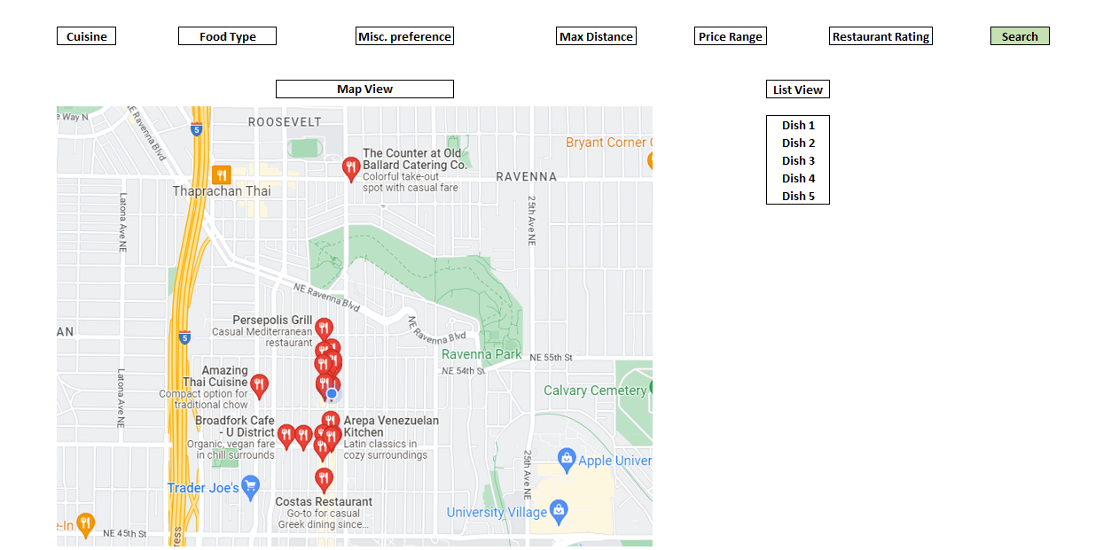
Wireframe

Slide 4



Python Package Choices
Streamlit: Streamlit Inc.
Framework that allows you to create web applications with Python.
To create interactive and dynamic data visualization tools and dashboards.
Has built-in mechanisms for handling user inputs and outputs, which could be useful for filtering food choices.
Yelp API: Yelp Inc.
Allows us to access Yelp's vast database of business listings and reviews.
To retrieve restaurant information such as location, hours of operation, and reviews,
Provides the ability to filter search results based on various parameters such as price, rating, and cuisine type, which could be used to narrow down food choices.
Scikit-learn: Scikit-learn developers
Machine learning library.
Includes algorithms for clustering, classification, and regression, as well as tools for model selection and evaluation.
Useful for developing the recommendation algorithm that powers the tool.

Slide 5



Python Package Choices (Continued)
Pandas: Pandas Development Team
Library for data manipulation .
Provides data structures for efficiently storing and manipulating large datasets, tools for filtering, sorting, and summarizing data.
Useful for organizing and filtering the restaurant and menu data.
Folium: Folium Development Team
Allows static and interactive world maps with street information.
Allows overlaid images, tooltips, etc.
Can embed graphs in tooltips
Google Maps: Alphabet Inc.
Can be used to retrieve directions from point A to B
Can generate static maps
Can generate dynamic maps via ipython
Can verify that addresses still exist
Data pulled in real time

Slide 6
Package Comparison: Streamlit vs Flask
Parameters | Streamlit | Flask
Addressing requirements | Designed specifically for building data science and machine learning tools | More general purpose, offers more flexibility for complex requirements
Compatibility within project | Compatible with other Python libraries and frameworks | Has a large ecosystem of plugins and extensions
Ease of use | Simple and intuitive API, easy to use and learn for beginners. | Requires some knowledge of web development and backend tech
Computational efficiency | Efficient for handling smaller-scale datasets | Efficient for handling larger datasets and complex computations
Availability of relevant examples | Has as a growing community of users and a large number of examples available online | Has a large and active community with extensive documentation and resources
Notes:
Designing a website

Slide 7
Package Comparison: Pandas vs Dask
Parameters | Pandas | Dask
Addressing requirements | Both can handle large datasets and provide a way to manipulate and analyze them using a variety of functions and methods
Compatibility within project | Both are compatible with many other Python packages and can be integrated easily
Ease of use | Easier to use, has a more straightforward API | Requires a high level of setup and configuration
Computational efficiency | Computationally less efficient, especially when dealing with very large datasets | Designed specifically to handle larger-than-memory datasets and can distribute computations across multiple cores or even multiple machines
Availability of relevant examples | Been around longer than Dask and is more widely used, so there are likely more examples available | Has a growing community and many resources are available as well

Slide 8
Package Comparison: Scikit-learn vs XGBoost
Parameters | Scikit-learn | XGBoost
Addressing requirements | Provides a wide range of algorithms | Focuses on gradient boosting methods
Compatibility within project | Both can be used with other packages and tools
Ease of use | Has a user-friendly and consistent API which makes it easy to use | Can be a bit harder to use as it has more configuration options and hyperparameters to tune
Computational efficiency | Efficient enough, but may not perform as well as XGBoost on very large datasets | Has a high computational efficiency, especially when dealing with large datasets
Availability of relevant examples | Has a large and well-documented set of examples and tutorials | Less commonly used in some industries and domains
Notes:
Explainability vs efficiency

Slide 9
Package Comparison: ‘Google Maps’ vs ‘Folium’
Parameters | Google Maps (connects to api) | Folium
Addressing requirements | Can be used to create static/interactive maps, provide directions, and verify if locations still exist. | Can be used to generate interactive maps, show tooltips, display markers, circles, polygons, etc.
Compatibility within project | Can give directions from point A to B in coordinates, which can be overlaid on a map. | Generated HTML files allow users to see where restaurants are located relative to themselves.
Ease of use | Requires api key on limited free trial. Have to use third party library due to no official support. API much more complicated. | Extremely simple
Computational efficiency | Partly depends on internet speed. | Millions of overlaid polygons will have performance issues.
Availability of relevant examples | Has an extremely large general user base. However many examples are ipython specific. | Has a solid community with decent documentation.

Slide 10
Package Choices
Decided to use both Google Maps for coordinate data and folium for the actual visualization (Efficient)
Streamlit: Easy, intuitive, interactive, Efficient enough
Scikit-learn: Explainability, Robustness, Flexibility, Documentation
Pandas: Simplicity, Compatibility, Familiarity

Slide 11
Drawbacks and Concerns
Google Maps directions data only return the coordinate points at which turns are made. This means for long stretches of road we currently do not know how to construct directions with polylines.
Google Maps API key is on a limited free plan right now, and its possible we may reach a request limit
Removing elements from a folium map may require either browser code or a complete remake of the map.
Streamlit: Deployment could be an issue
Scikit-learn: Performance when compared to other models, Speed
Pandas: We are very used to it and might not overlook. Speed, scalability, parallelization

Slide 12
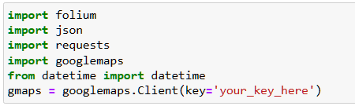
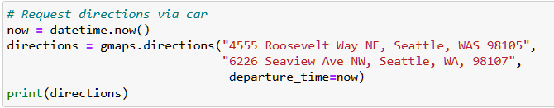
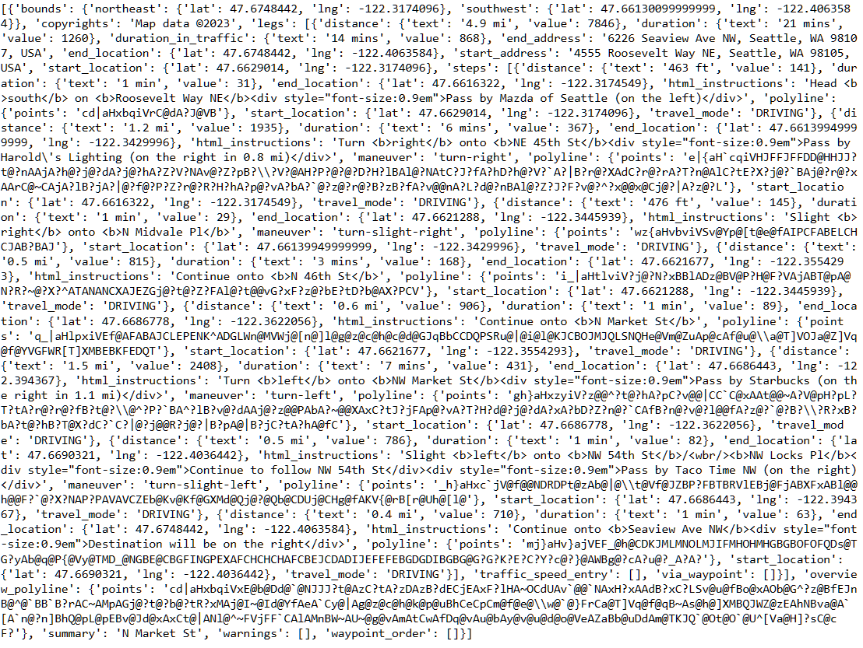
Demonstration: Google Maps and Folium
Imports and API key
Get directions via Google Maps API
As you can see, output needs to be parsed!

Slide 13
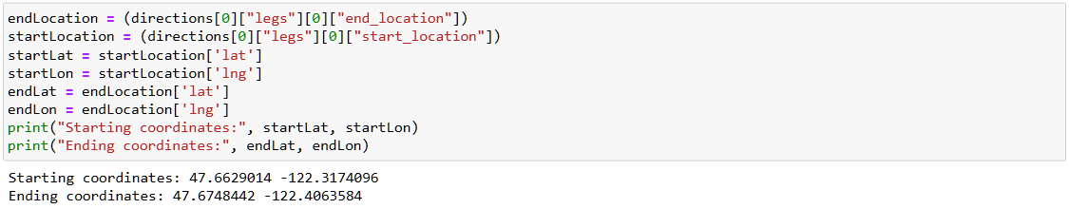
Parsing start/end destination coordinates, as well as trip coordinates (Lat, Lon)
Coordinate ranges: (-90 to 90), (-180 to 180)

Slide 14
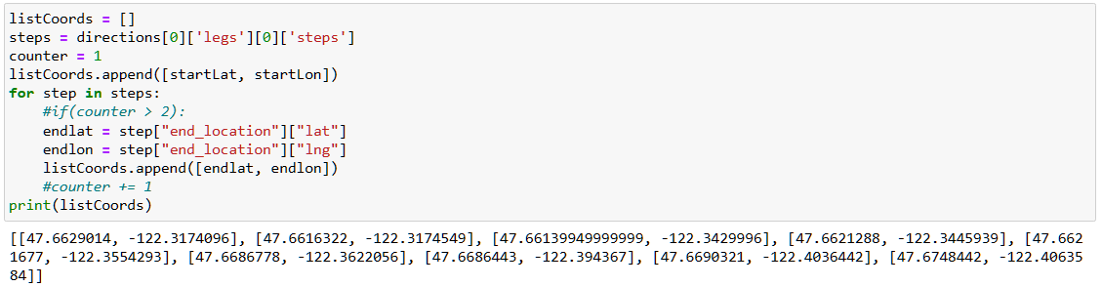
Parsing start/end destination coordinates, as well as trip coordinates (Lat, Lon) Continued

Slide 15
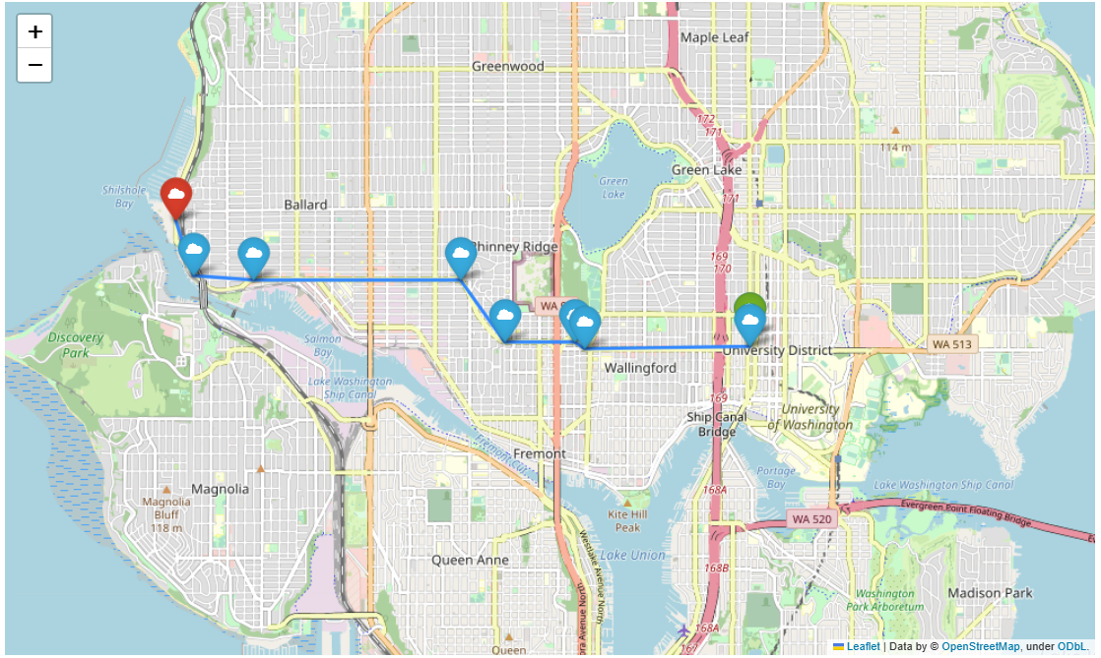
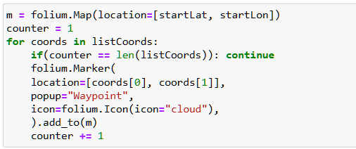
Adding markers/polylines on the folium map at the specified coordinates
Shows directions from start to finish. Markers can be customized to have different colors, icons, tooltips, hover rules, etc. The map is typically interactive but can be static if needed.

Slide 16
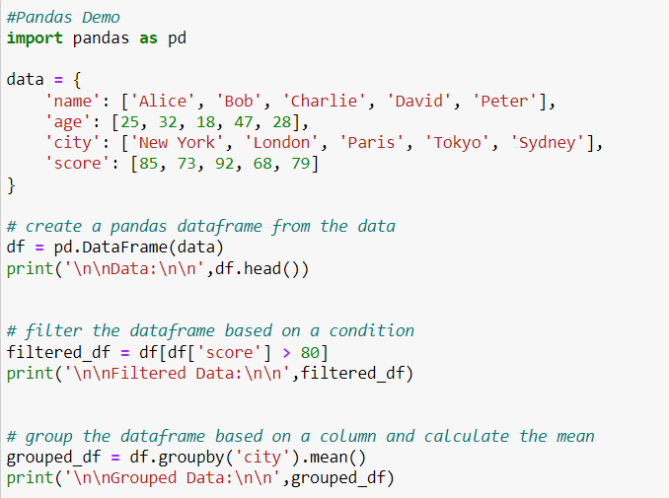
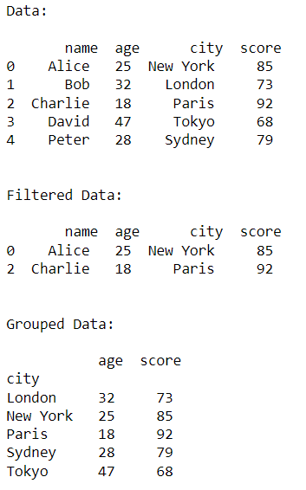
Pandas Demo

Slide 17
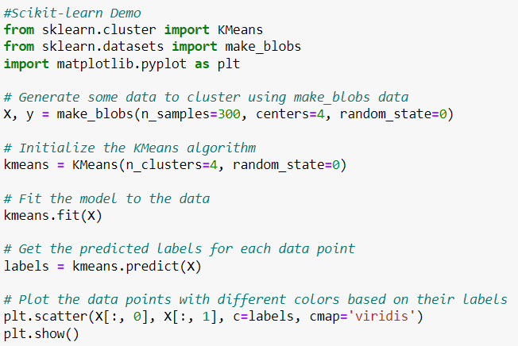
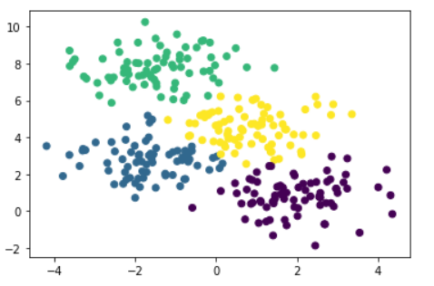
Scikit-learn Demo:

Slide 18
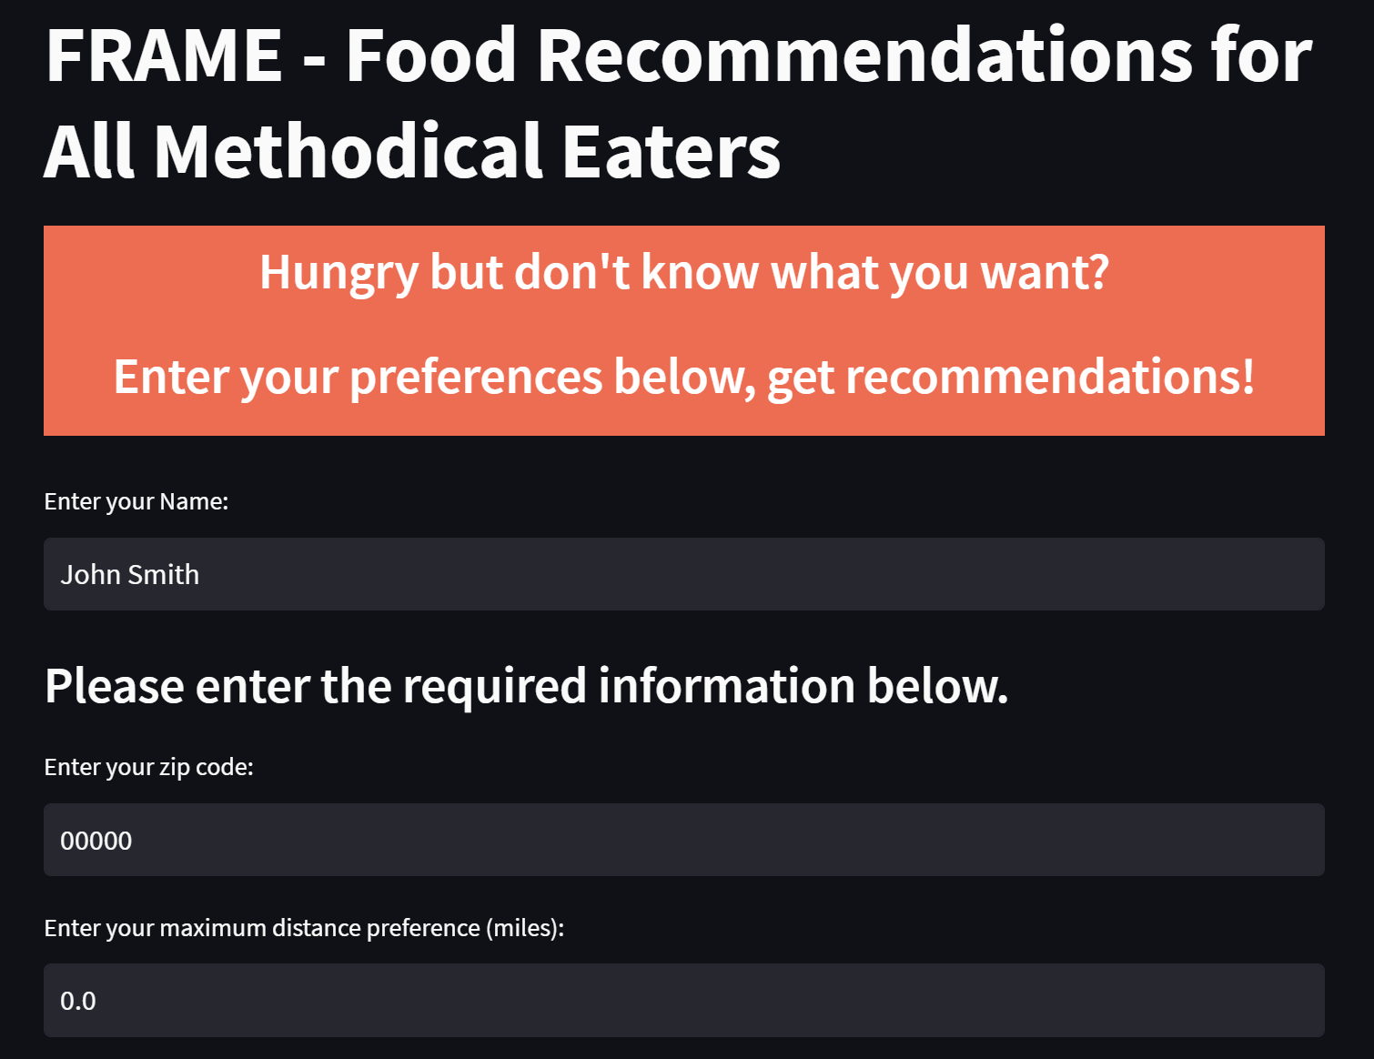
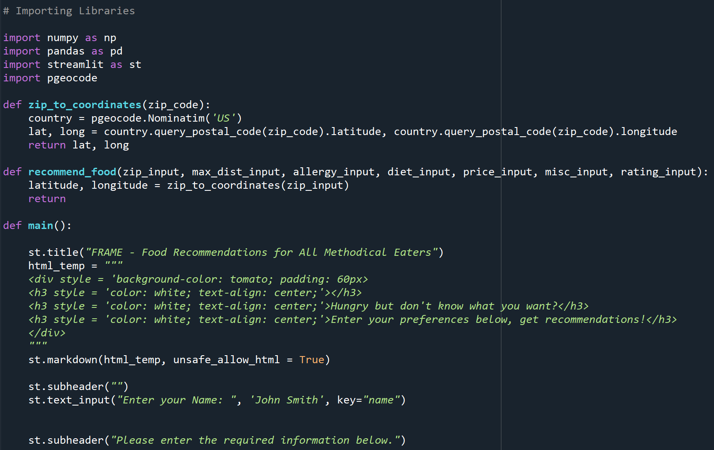
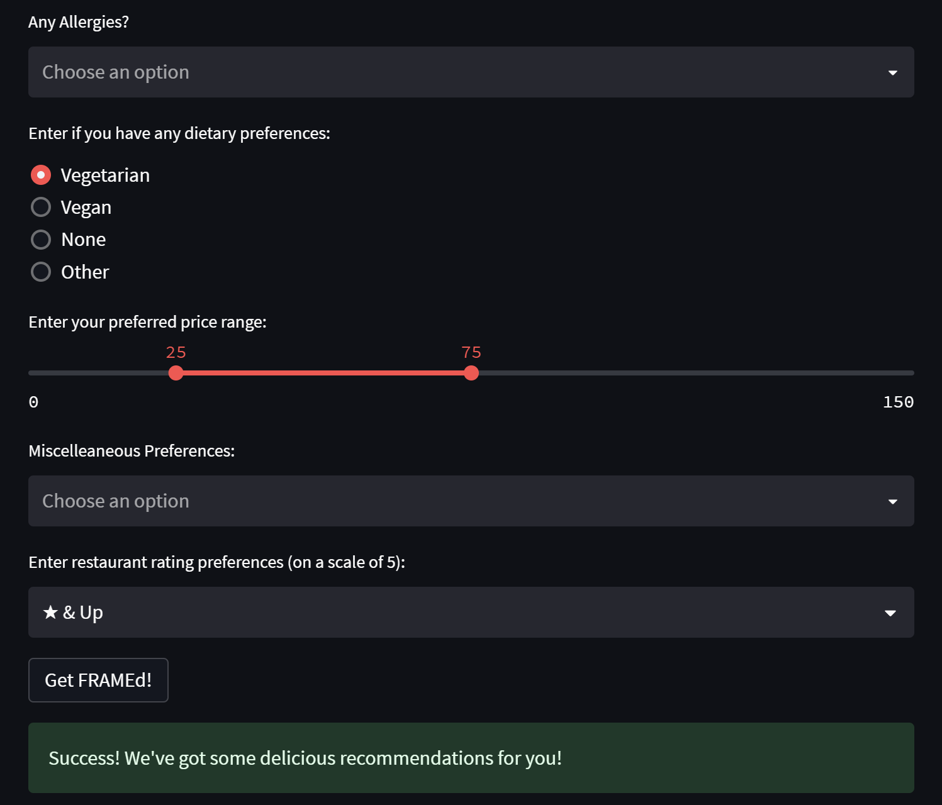
Streamlit Demonstration

Slide 19


